Slide 1

Flight Delay Prediction
MIDS w261: Machine Learning at Scale | UC Berkeley School of Information | Summer 2021
Team 07: Atreyi Dasmahapatra, Kanika Mahajan, Kevin Fu, Lucas Barbosa

Slide 2

Business Case
Predicting flight delays allow airlines to do better delay management, optimizing their operations and saving costs
Ex. should a connecting flight be intentionally delayed if a feeder flight arrives with a delay?
If not, transferring passengers will lose their connection; if yes, another delay might cause ripple effects in the network
With in advance delay predictions, airlines do have more flexibility to reschedule in an optimized way

Slide 3

Recall is key
Since most of flights do not delay, a classifier that simply predicts that no flights will be delayed can achieve remarkably high accuracy rates
Thus, our main challenge is to instead improve recall, the percentage of delayed flights that are correctly classified as delayed
Key assumption: costs incurred in anticipation of a potentially delayed flight that doesn’t delay are lower than the costs of a delayed flight for which the airline has not prepared itself

Slide 4
The datasets we used
Airline Dataset: Bureau of Transportation Statistics (BTS).
31 million rows
109 potential features
Weather Dataset: Integrated Surface Data (ISD)
630 million rows
177 potential features
Aviation Support Tables: Office of Airline Information, Bureau of Transportation Statistics
18K rows
10 potential features
Notes:
As we will go into more detail later, the airline dataset proved to be the most predictive dataset out of the 3 datasets, even compared to the overwhelmingly larger weather dataset.
In addition, we did not take a deep dive into Aviation Support Table because: we used the Google Maps API to calculate distance from the airport to the weather station, which we deem to be more accurate than the data in the Aviation Support Table.

Slide 5
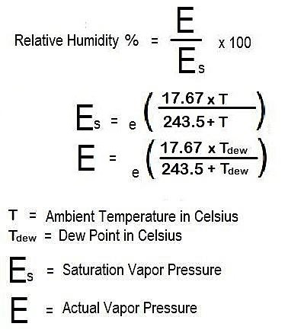
Key findings from EDA: weather data
Many unusable/null values
7 predictive features, 42 million rows remain
Not one single feature indicates bad weather
98.6% normal wind conditions
4.2 m/s avg wind speed (gentle breeze)
0.8 correl (air temp, dew temp)
Led to creation of Bad Weather Predictor:
>50% relative humidity &
Wind speed >15.2 m/s |
Required visibility <1609 m |
Low sea pressure (bottom 10%)
Notes:
630m -> 42m. 177 -> 7 features.
As expected, overwhelming amt of weather data = Skewed towards normal weather conditions. To illustrate, here’s a glimpse of the summary stats.
4.2 m/s = Gentle Breeze category on the Beaufort Scale (measures severity of wind speed)
Bad Weather Predictor: Yielded 4m rows (10% of dataset) - in line with root causes of flight delays (~7-10%) as we will see later
RH: <50%: Dry, >50%: Rain
Challenges: Reading the Federal Climate Complex document and making sense of the geophysical weather lingo.

Slide 6
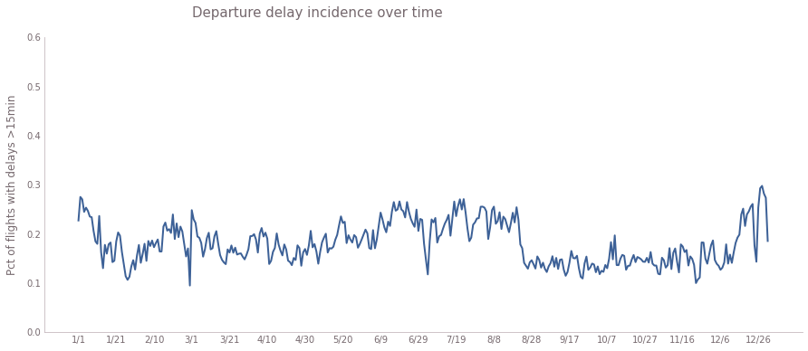
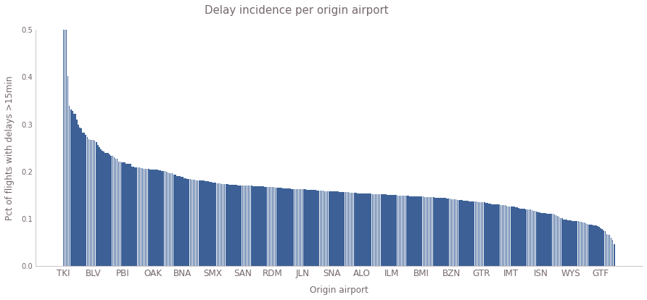
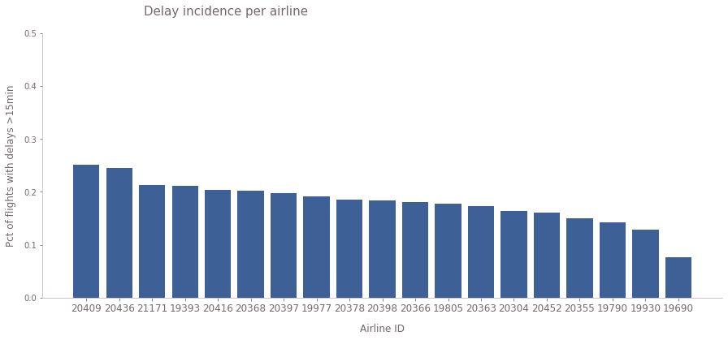
Key findings from EDA: airlines data
Duplicate and Missing Data (61 potential features)
Cancelled and Diverted Flights
Average delay time ~ 12 minutes
Average flight duration (~800 miles, 2.5 hours)
Imbalance in outcome of interest
Delayed flights not uniform across days, airlines, airports
Departure delay incidence over time
Pct of flights with delays > 15 min
Delay Incidence per Single Airport
Delay incidence per airline carrier
Pct of flights with delays > 15 min
Pct of flights with delays > 15 min
Origin Airport
Airline ID

Slide 7
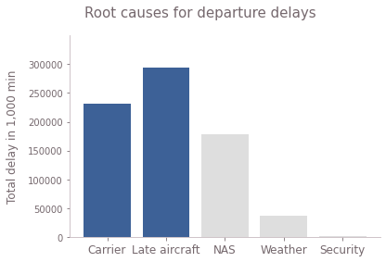
Flight delays and feature creation
Air Carrier delays:
Average delayed flights (rolling window 30 days) for every aircraft.
Late Aircraft delays:
Frequency of delayed flights at origin, destination airport and by airline carrier in the past 2, 4, 8 and 12 hours
NAS delays:
Frequency of late arrivals in the departure airports
Delays in hubs in the past 2,4,8 and 12 hours
Part of Day (Morning, Afternoon etc.)

Slide 8
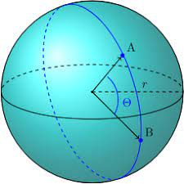
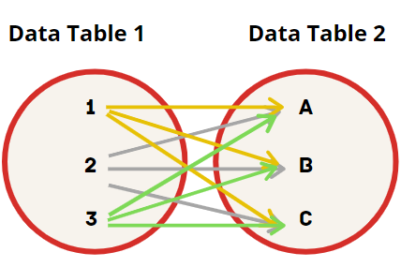
Joining Data Tables
Nearest weather station to departing airport
Use Google geocode api to get latitude and longitude of departing city
Map back to matching weather station latitude and longitude using Haversine formula
Cross Join first and then inner join
Latest weather timestamp
26513705 rows and 128 features
Very few empty rows (as expected)
Great-circle distance between two points on a sphere
Notes:
Haversine formula - standard method

Slide 9
Our modelling pipeline
One pipeline per algorithm (LR, SVM, RF, GBT)
- Oversampling minority class
- StringIndexer
- OneHotEncoder
- Imputer
- VectorAssembler
- Scaler
- ModelClass (e.g. Logistic Regression)
- TimeSeriesCrossValidation (custom class)
Raw airlines data
Train data
Augmented Train data
Pipeline
- Cleaning
- Feature engineering
- New features creation
Ready-to-join airlines data
- Train/ test split
Test data
- Model Transform
- Join
Ready-to-model data
Best model (after cross-validation and hyperparameter tuning)
Modification of standard behaviour of CrossValidation class to allow Cross Validation on a Yearly Rolling Basis
Ready-to-join weather data
Predictions
- Cleaning
- Feature engineering
- New features creation
- Evaluator
Checkpoints at blob
Raw weather data
Performance metrics
Datasets
Models
Transformations
Notes:
F1 score is not that important

Slide 10
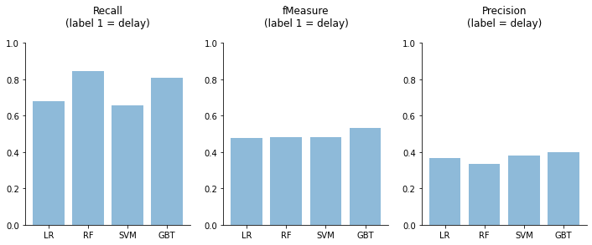
Results
84.5%
Mid-point presentation baseline
80.8%
68.0%
65.6%
53.2%
49.6%
52.9%
46.7%
47.8%
48.1%
48.3%
38.2%
39.7%
36.9%
33.6%
Notes:
F1 score is not that important

Slide 11

Conclusions and Challenges
First ever ML project with datasets that couldn’t be tweaked in Pandas
Application of LR, RF, SVM and GBT algorithms
LR from scratch: recall of 0.43 (vs 0.68) and a precision of 0.29 (vs. 0.37)
Flight data lacked timestamps and had local time - calculate local time zones convert both flight & weather data to unix timestamps
A common column between the two data tables to join did not exist
The joined dataframe gets saved as a parquet file without any complaints but count of the data frame is drastically lower upon reloading
Notes:
We faced several challenges over the course of this project which were not just limited to cluster inefficiencies and dearth and time.
We were unlucky in not being able to work with the full dataset due to unexplainable technical difficulties but we made sure that our data (of 2 million rows) was a good representative sample of the total population of 26 million rows.

Slide 12
OLD SLIDES REPOSITORY
Notes:
F1 score is not that important

Slide 13

Flight delays cause extra costs for passengers and airlines
Longer trips
Missed connections
Lengthy stays at airports
Crew/aircraft availability
Passenger reaccommodation
Penalties/fines
Personal and professional costs
Operational costs and brand reputation

Slide 14
Airlines Dataset: EDA
Data Overview
Started with airlines 3 months data: Total 109 features and 161057 rows
Missing Data
Removed features that had > 96% of data missing (mostly diverted flights)
Usable features went down to 61
Data Cleaning
Cancelled flights removed from dataset (unable to classify if delayed or not)
Diverted flights left as such
Notes:
48 features removed
~4900 cancelled flights
~387 diverted flights

Slide 15
Feature engineering - Airlines data
Part of the day ( snowball effect of delayed flights early in the day)
Average delayed flights by aircraft (tail_num) - rolling window 30 days
Frequency of delays in the departure airport (for all airlines) in the past 2, 4, 8 and 12 hours
Frequency of delays in the destination airport (for all airlines) in the past 2, 4, 8 and 12 hours
Frequency of delays of the same airline (in the departure airport) in the past 2, 4, 8 and 12 hours
Frequency of late arrivals in the departure airport (for all airlines) in the past 2, 4, 8 and 12 hours

Slide 16
Weather Dataset: EDA
Remove Missing/Erroneous Features (Columns)
161 out of 177 features had 50%+ missing data (91% reduction)
Remove Missing/Erroneous Rows
11,588,530 rows remain out of 29,823,926 (61% reduction)
Data Cleaning
Total of 19 useable features, un-nested from 6 columns
Notes:
High correl if?: More Missing data + non important weather stations, Less missing data + more important weather stations?
Vini: Fill in the dataset after joining. Backward fill only. No forward fill.
Vini: Focus on imbalance for the full dataset.
Vini: On weather: temperature is ok to take the nearest. However, for rain/snow, take the max(period of time) as opposed to just the nearest. So Max might be more important than Avg.
Vini: Do a correlation matrix. eg. Dew point and Temp are highly correlated.

Slide 17
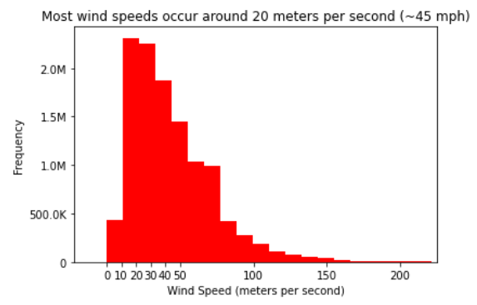
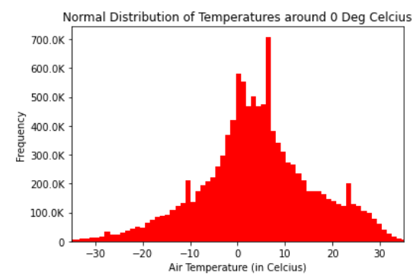
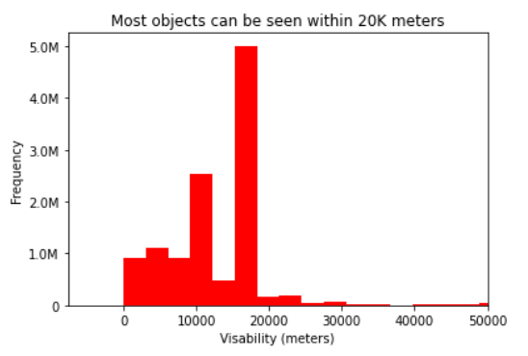
Weather Dataset: EDA
0.70 correl(air temp, dew temp)
-0.23 correl(sea level, visibility)
Notes:
Avg Wind speed: 44 meters/second
Avg Visibility: 12500 meters
Avg Air Temp: 9.4 degrees C
More than half of Sea level pressure data is missing (99999 = Missing). However, I dont want to destroy other data pieces that might be useful by deleting the whole row.

Slide 18
Feature engineering - Weather data
6 out of the 19 features could be predictive
Others were identifying features
To use Lasso as final judge to determine if var is sig predictor for flight delays
Filling in vs. Removing x million rows may make features more significant
Good vs. Bad Weather
Within explicitly labeled variables, 90%+ “Good”, <10% “Bad”
Need more “Bad” weather data points: must look into 6m/Full dataset for a complete Season/more Winter data points
Notes:
In order of importance in terms of predictiveness/importance, weather is 4th
As david said, airplane’s tail number prob more predictive than weather
Aggregated weather condition = Bad weather

Slide 19
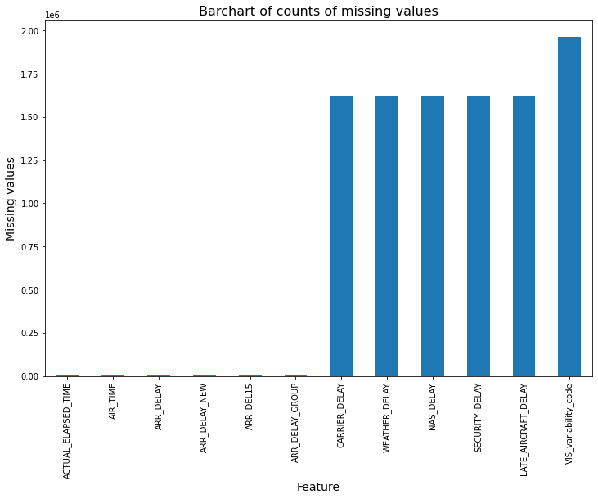
Joined Dataset: EDA
26513705 rows and 128 features
Very few empty rows (as expected)
Name of Origin City | Bad Weather Prediction
Chicago, IL | 53932
DFW, TX | 35192
Atlanta, GA | 32135
Phoenix, AZ | 29293

Slide 20
Logistic Regression: baseline results
Only 4 features survived after L1 reg.; none from the weather dataset
Recall of ~60%: too good to be true?
Features | Weights
Intercept | -1.680632
Total number of departure delays in the previous 2hrs in the origin airport | 0.002778
Total number of departure delays in the previous 4hrs in the destination airport | 0.228222
Total number of arrival delays in the previous 2hrs in the origin airport | 0.008814
Total number of arrival delays in the previous 4hrs in the origin airport | 0.000651
Performance metrics
--------------------------------------------------
Accuracy: 0.7984
Weighted Precision: 0.7902
Weighted Recall: 0.7984
F1-Score: 0.7938
Precision By Label: [0.8607, 0.5286]
Recall By Label: [0.8878, 0.4670]
F1-Score by Label: [0.8740, 0.4959]

Slide 21
Next steps
EDA and join on complete dataset
More feature engineering - Airport hubs and frequency of delays, Late arrivals and airports, Weather features
Lasso on additional combinations of features
Test on ensemble models based on classification trees

